Slide 1
SUPERSTORE SALES
PERFORMANCE ANALYSIS
Excel Capstone Project
Idika Dave-manny Ugochukwu
Tools: Microsoft Excel • PivotTables • PivotCharts • Slicers • Dashboard Design

Slide 2
Project Objective
This project analyses Superstore sales data to identify sales trends, profitable products, valuable customer segments, and operational factors affecting profit.
↗
$
◎
⚙
Sales Trends
Profitability
Customer Value
Operations
Track performance over time and by region
Identify which products drive or drain profit
Find the most valuable customer segments
Assess shipping and return impacts
Superstore Sales Performance Analysis
2

Slide 3
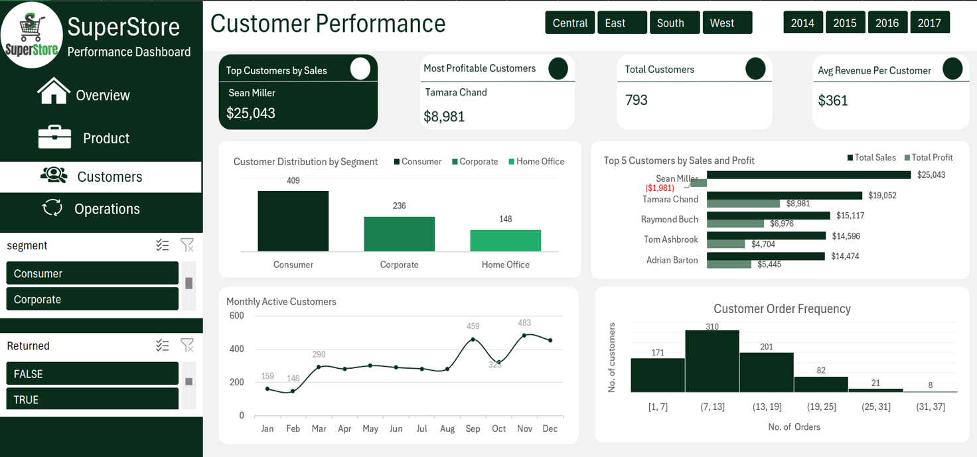
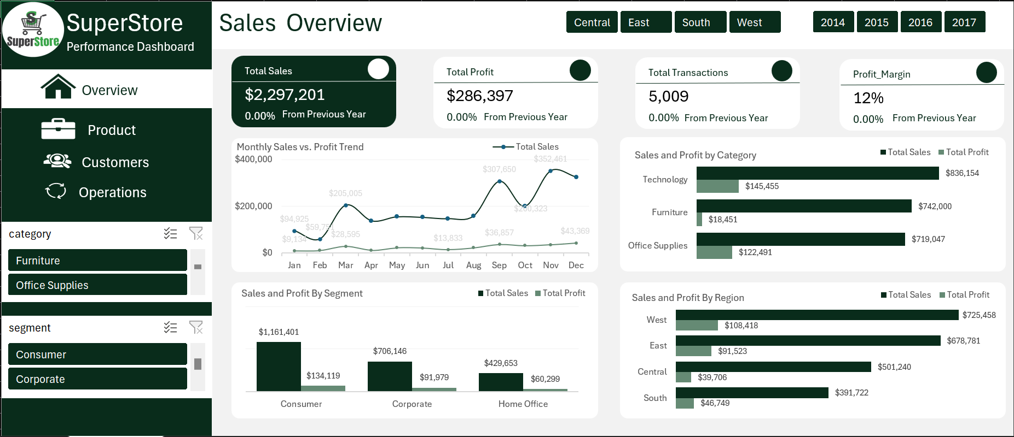
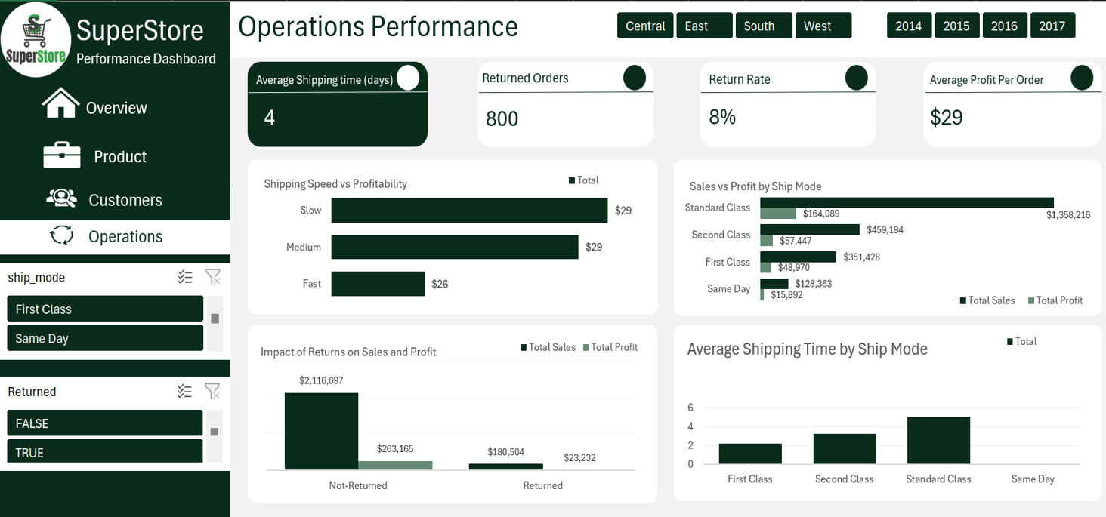
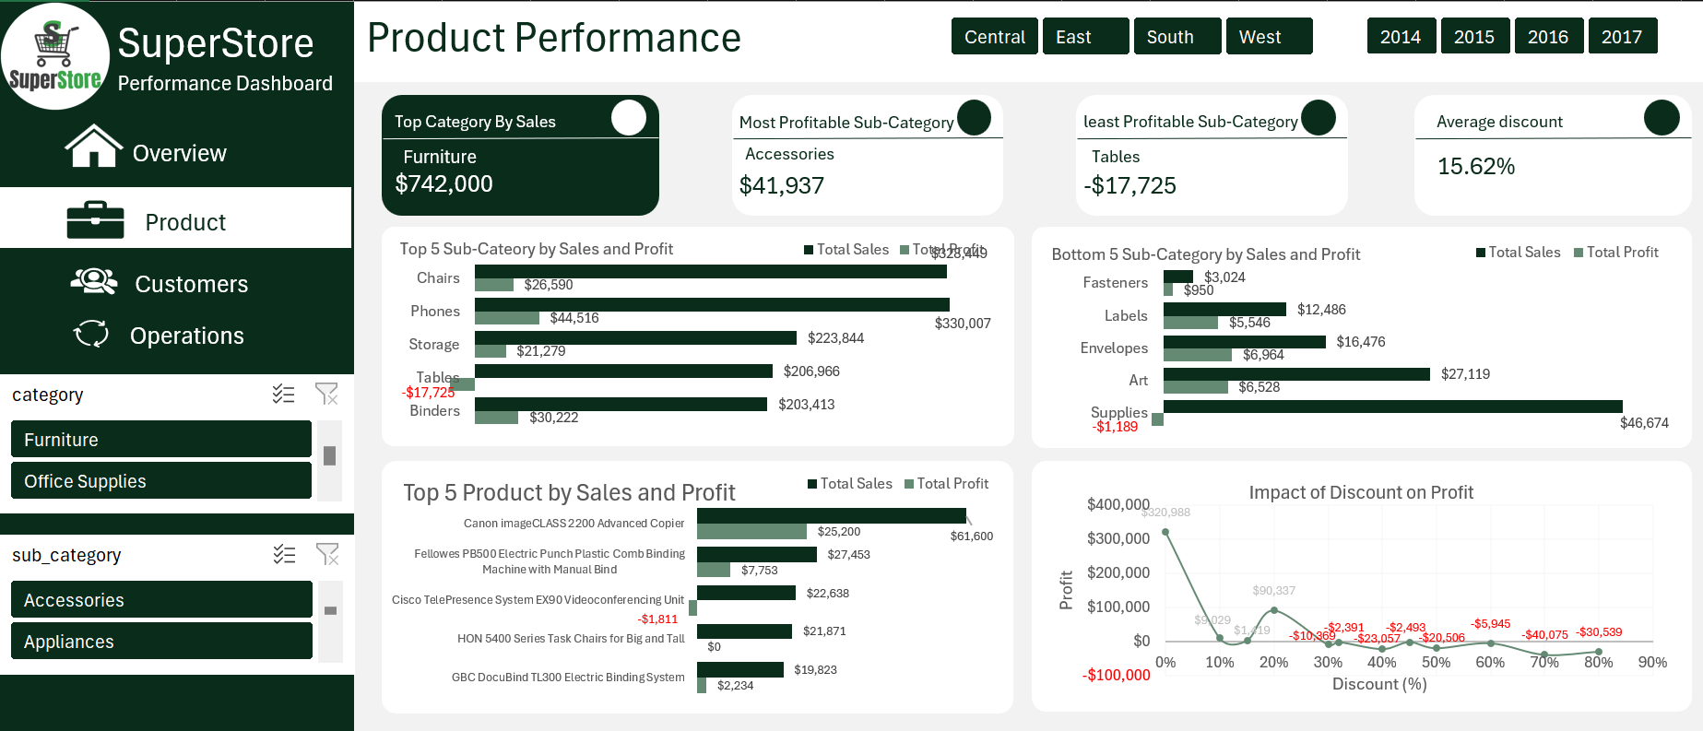
Dataset & Dashboard Overview
DASHBOARD PAGES
DATASET
▣
◎
⚙
▣
◎
▣
◎
⚙
↗
⚙
↗
↗
Data Period
Product
Customer
Operations
Product
Product
Customer
Customer
Operations
Overview
Operations
Overview
Overview
2014 – 2017
Main Fields
Sales
Profit
Discount
Category
Customer Segment
Region
Ship Mode
Returns
3
Superstore Sales Performance Analysis

Slide 4
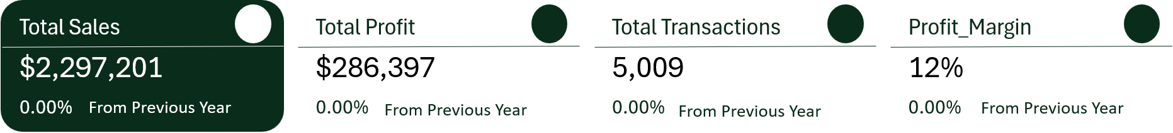
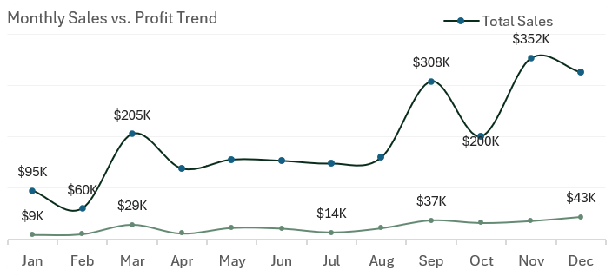
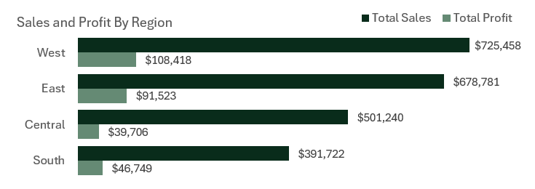
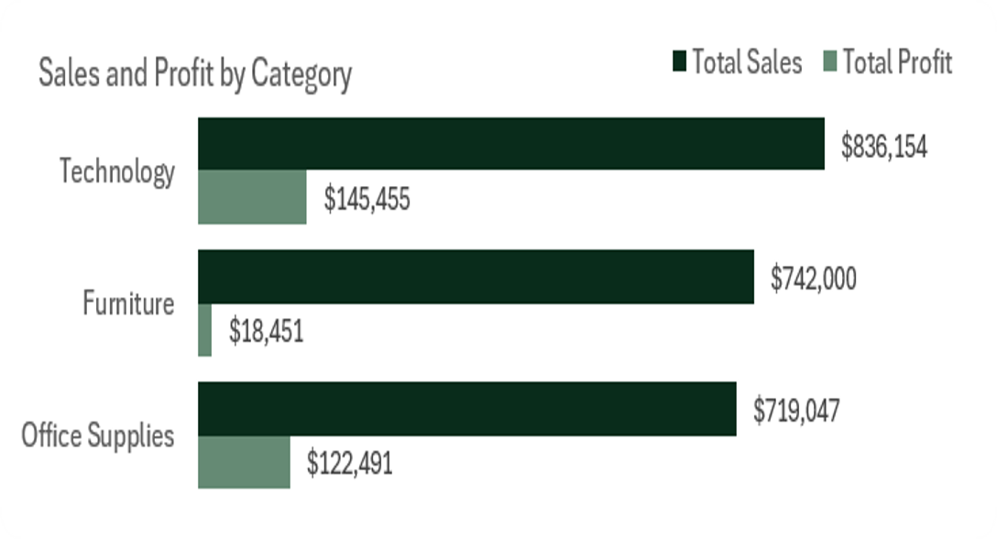
Overall Business Performance
Figures reflect the full dataset with all dashboard filters reset
Total Sales
Total Profit
Total Transactions
Profit_Margin
$2,297,201
$286,397
5,009
12%
0.00%
From Previous Year
0.00%
From Previous Year
0.00%
From Previous Year
0.00%
From Previous Year
KEY FINDINGS
Sales rise strongly toward the final months of the year.
The West region generates the highest sales.
Technology produces the highest profit among the main categories.
4
Superstore Sales Performance Analysis

Slide 5
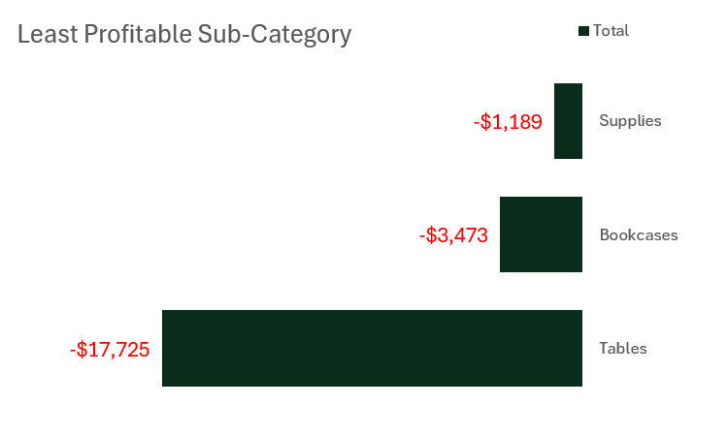
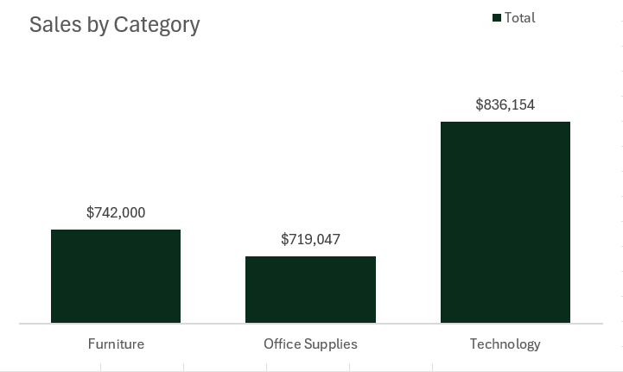
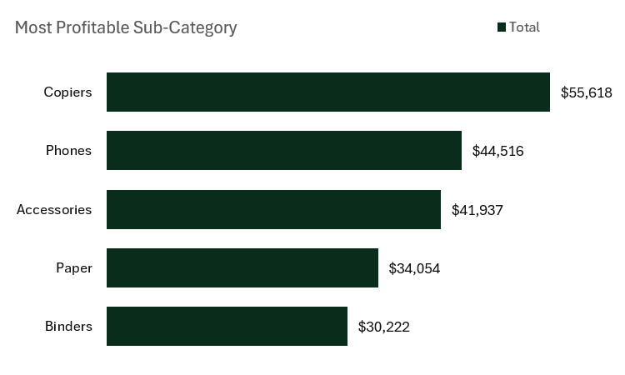
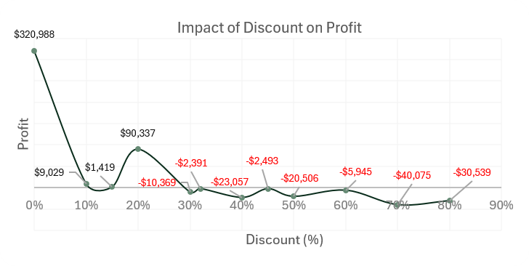
Product Performance Insights
▣
$
!
%
▣
$
!
%
Technology has the highest category sales.
Copiers is the most profitable sub-category.
Tables records a loss of $17,725.
Higher discount levels are linked with falling profit and losses.
Technology has the highest category sales.
Copiers is the most profitable sub-category.
Tables records a loss of $17,725.
Higher discount levels are linked with falling profit and losses.
5
Superstore Sales Performance Analysis

Slide 6
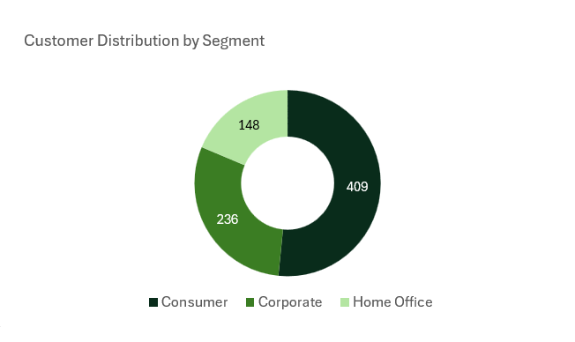
Customer Performance Insights
TOP CUSTOMER BY SALES
Sean Miller
🏆
Highest total sales among all customers
MOST PROFITABLE CUSTOMER
$
Tamara Chand
Highest total profit contribution
Most customers place between 7 and 13 orders — a healthy, repeat-purchase pattern across the customer base.
◎
6
Superstore Sales Performance Analysis

Slide 7
Operations Performance Insights
🚚
↺
4 days
8%
AVG. SHIPPING TIME
RETURN RATE
KEY FINDINGS
Standard Class generates the highest sales and profit.
Returned orders generate far less sales and profit than non-returned orders.
7
Superstore Sales Performance Analysis

Slide 8
Recommendations
Actions derived directly from the analysis findings
Review discounts above 20%, especially on low-margin products.
Investigate why Tables produces losses despite strong sales.
1
2
Prioritise profitable sub-categories such as Accessories.
Maintain strong service for high-value customers and the Consumer segment.
3
4
Review return reasons and reduce preventable returns.
Monitor Standard Class shipping performance because it drives the largest share of sales.
5
6
8
Superstore Sales Performance Analysis

Slide 9

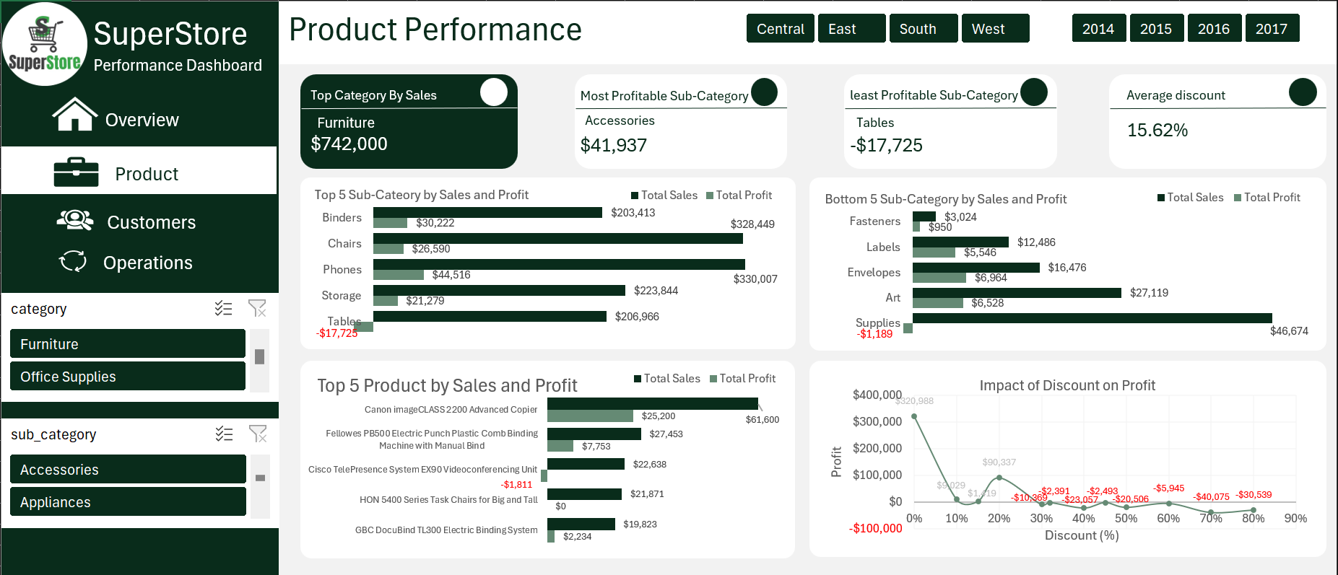
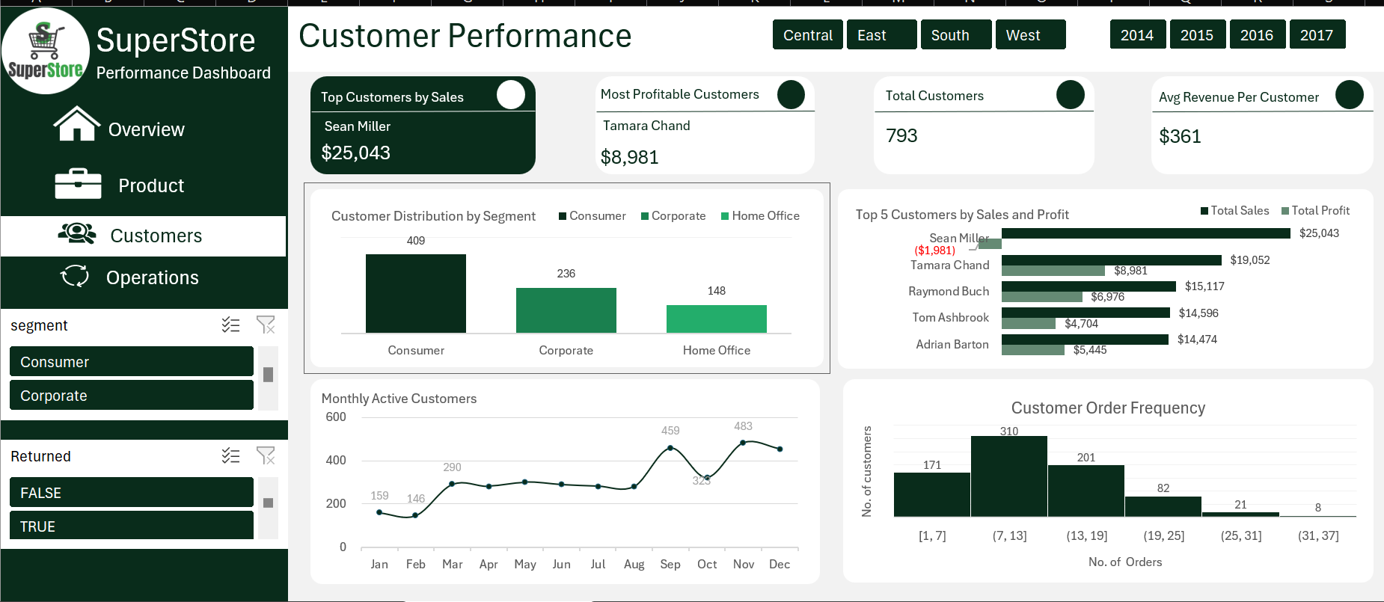
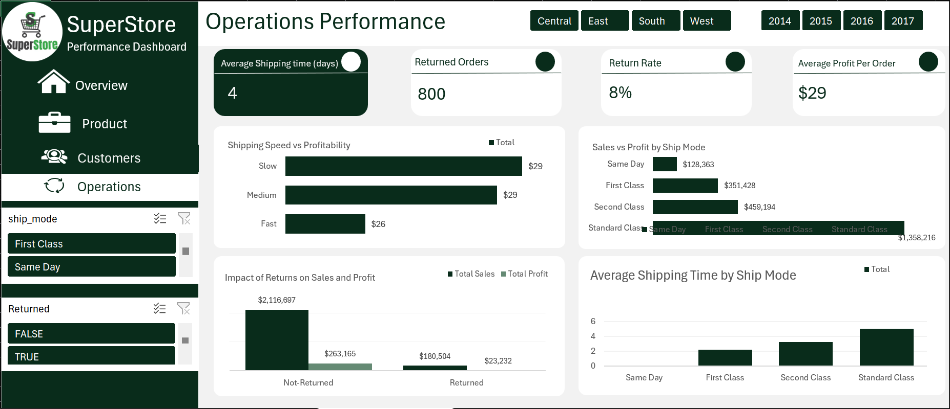
Superstore Sales Performance Analysis
Conclusion
The analysis identified sales growth patterns, profitable products, valuable customers, and operational issues. The Excel dashboard gives decision-makers a way to track these areas by region, year, category, segment, ship mode, and return status.
DASHBOARD PREVIEW
9

